Slide 1

The decision game
English 3-2023- JULIANA vIVIANI

Slide 2

It´s game time !
Task 1: After playing the game, write a report, ( about 200 words), describing your decision itinerary. Use: Simple Present,Present Continuous, Simple Past, Past Continuous and Present Perfect.
Task 2: Imagine this exact situation happens in Argentina. Write down a report (about 200 words) describing how you would solve the situation.
Task 3:Are your strategies similar? Are they different? Why? Write your answer in 5 lines.
Hand in your paper and celebrate because this is the end of your exam.

Slide 3

MISSION
Let the games start !!
You work at the Central Bank, a British bank with branches in most towns and cities.
All of your call centres are based in the UK, in areas of high unemployment.
You must make a series of decisions which will affect the future of these call centres.
Make your first decision by choosing option a or b.
Click on the hand to start.
Good luck!

Slide 4

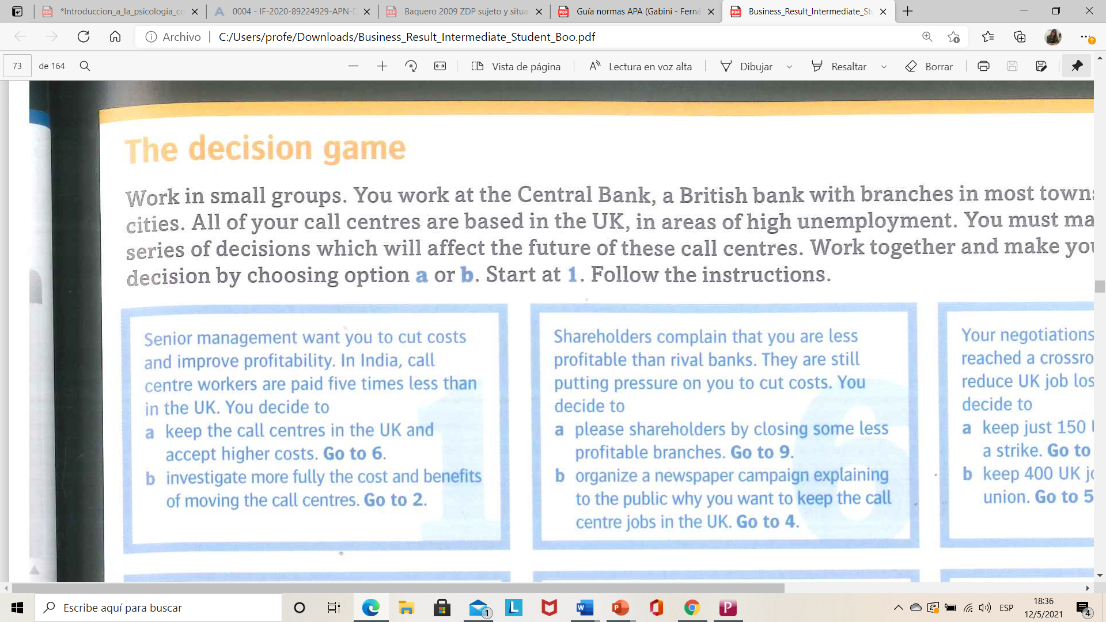


Esta foto de Autor desconocido está bajo licencia CC BY-SA

Slide 5
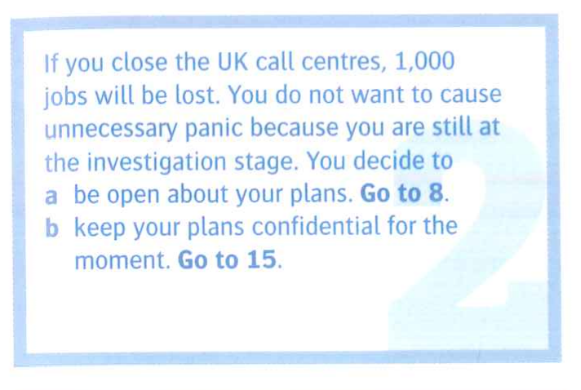


2
¿

Slide 6
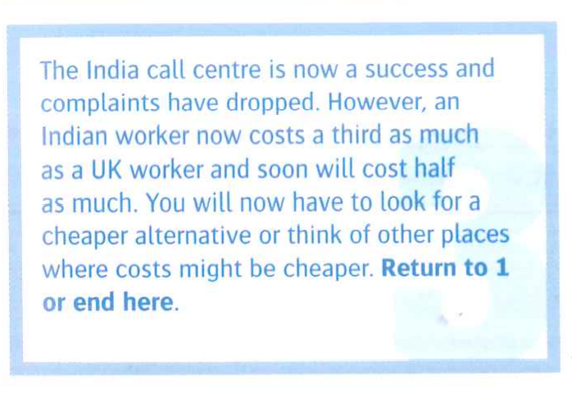

3

Slide 7
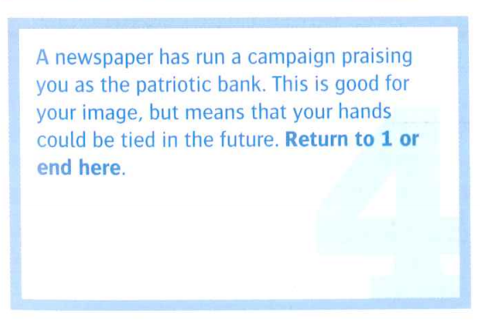
4

Slide 8
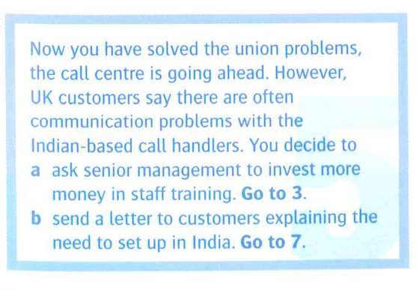


5

Slide 9
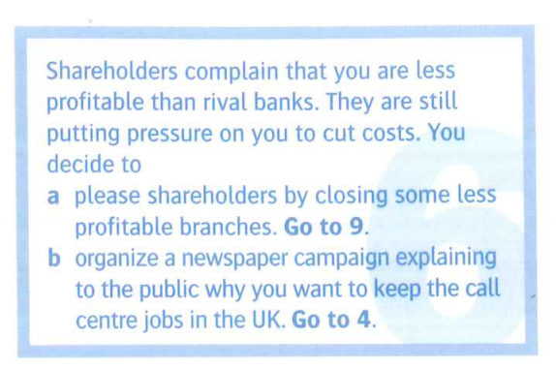


6

Slide 10
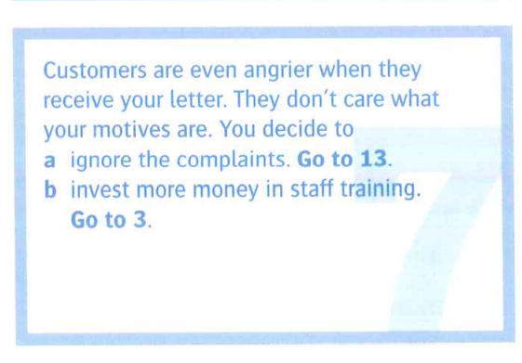

7

Slide 11
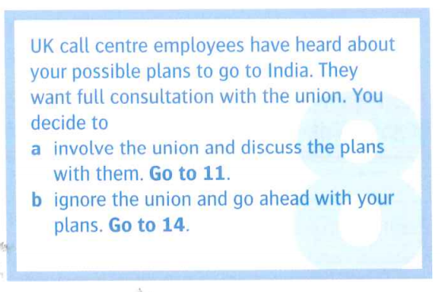


8

Slide 12
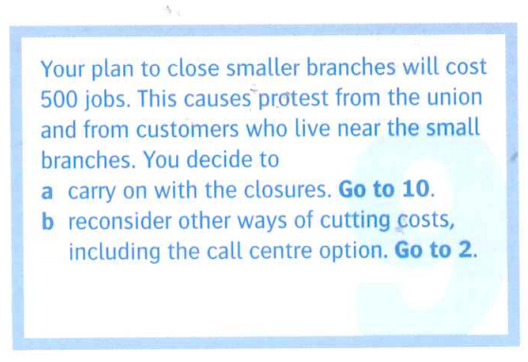


9

Slide 13

10

Slide 14
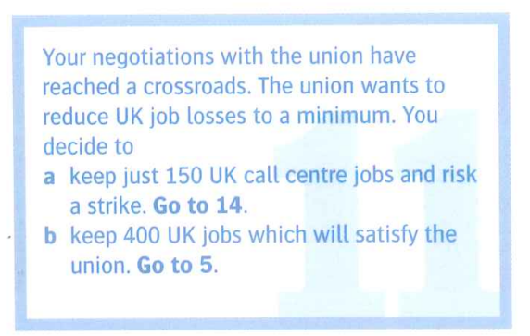

11

Slide 15
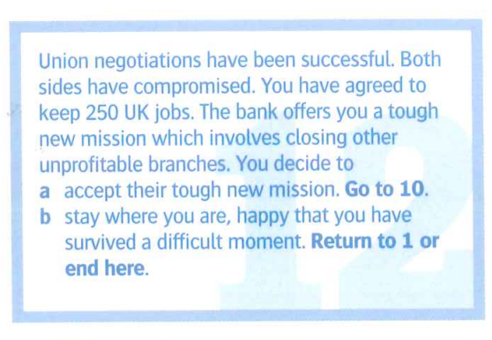

12

Slide 16
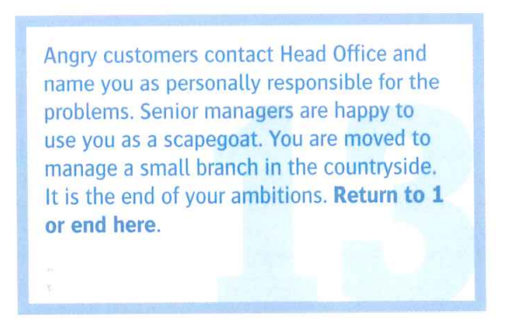
13

Slide 17
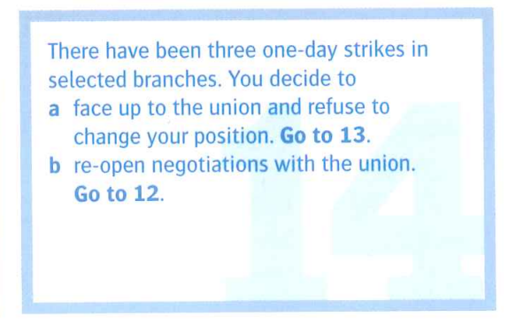

14

Slide 18
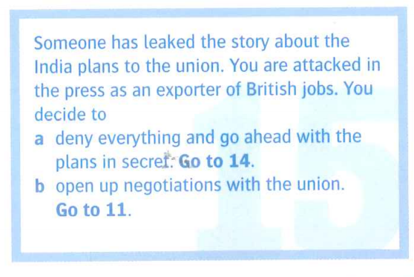

15

